Slide 1
COELOM and ITS EVOLUTION
DR. SEEMA JYOTI
ASSOCIATE PROFESSOR
DEPARTMENT OF ZOOLOGY
MANGALDAI COLLEG

Slide 2
COELOM: INTRODUCTION
The term coelom was suggested by Haeckel in 1872.
A coelom (Greek: coel = hollow cavity) is a fluid-filled cavity
between the alimentary canal and the body wall lined on all sides
by mesoderm.
Features of a True Coelom
¨ It is a secondary body cavity formed by the splitting of mesoderm
during embryonic development.
¨ It is also bounded on all sides by a definite coelomic epithelium.
¨ It consists of colourless coelomic fluid also the excretory organs open
into it.
¨ Reproductive organs arise from its walls.

Slide 3
Coelom or true body cavity generally refers to a large fluid-filled space lying between the outer body wall and the inner digestive tube.
The coelom is the main body cavity in most animals and is positioned inside the body to surround and contain the digestive tract and other organs.
It arises as a secondary cavity between the two layers of embryonic mesoderm and contains most of the visceral organs.
In some animals, it is lined with mesothelium. In other animals, such as molluscs, it remains undifferentiated.
In the past, and for practical purposes, coelom characteristics have been used to classify bilaterian animal phyla into informal groups.
*(The mesothelium is a protective membrane that covers the lungs, abdomen, heart and testes.)

Slide 4
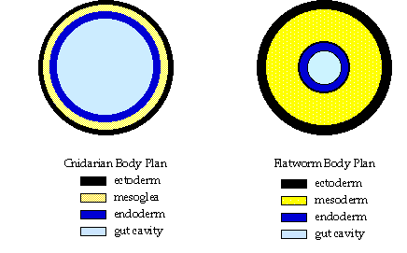

Slide 5
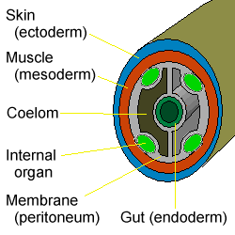
The coelom is one of the characteristic features of metazoans. The true coelom is a body cavity formed during embryo development from the three germinal layers. The coelom is lined by mesodermal epithelium cells. Presence or absence of coelom is one of the criteria for classifying animals.
The animal kingdom is divided into three groups on the basis of the nature of coelom.

Slide 6
CHARACTERISTICS OF COELOM
Developmentally coelom arises as a split in the mesoderm which becomes bifurcated into two layers, a somatic layer lying next to the epidermis and a splanchnic layer around the endoderm.
Coelom becomes bounded on all sides by coelomic epithelium which secretes coelomic fluid.
The greater part of the coelom forms the perivisceral cavity or splanchnocoel.
It is a fluid-filled space inside which is lodged the viscera.Because of this packing the viscera remains independent of the movements of the muscles of body wall.
In some higher animals part of the perivisceral cavity is kept separate to form restricted cavities whose coelomic nature can and only be realised if their developmental history is followed.
In all probabilities the ancestral coelomate animals had segmentally arranged mesodermal pouches.From these pouches gametes were formed by the process of proliferation of the epithelial lining.Later on, these pouches became modified in structure and function.
The evolution of mesodermal pouches is evident in present day coelomates.

Slide 7
TYPES OF COELOM
SECONDARY COELOM
PRIMARY COELOM
Also called as false coelom or pseudocoelom.
Derived from the blastocoel of the embryo.
Internal organs remain free in it since it is not bound by peritoneum or mesoderm
It is a space enclosed by ectoderm on outside on the inside & not by mesoderm on both sides.
Ex: Rotifers & roundworms etc.
The blastocoel is gradually obliterated by the embryonic archenteron without forming a primary coelom.
Instead, a secondary or true coelom develops within the embryonic mesoderm and lined by a characteristic layer of flattened mesodermal epithelial cells, known as peritoneum, which also surrounds internal organs.
Ex: Annelids

Slide 8
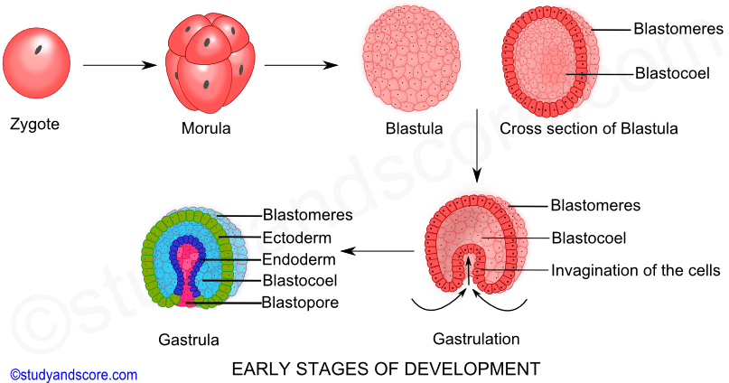

Slide 9
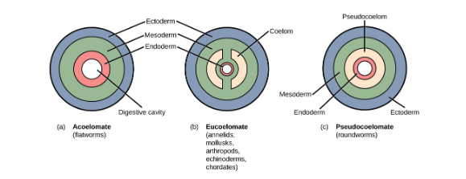
ORGANIZATION OF BILATERIA BASED ON COELOM

Slide 10
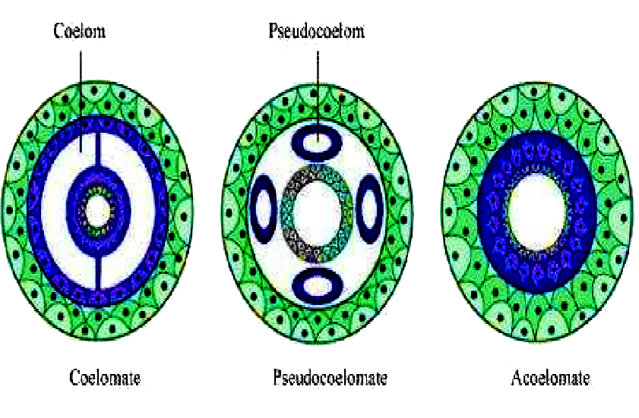

Slide 11
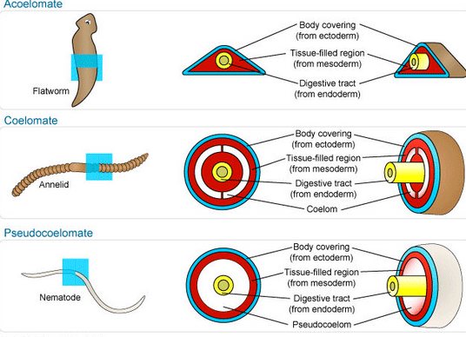

Slide 12
3 types of structural body formation present in animals related to coelom:
1.Acoelomate | 2. Pseudocoelomate | Eucoelomate: divided into Protostomes & Deuterostomes
Coelom is absent. | True coelom is not present. | True coelom is present.
The blastocoel is completely occupied by mesoderm | The blastocoel is partly filled by mesodermal cells. | The blastocoel present in the gastrula gets completely replaced by a true coelom. The body organs are suspended in the coelom by mesenteries.
Ex. Porifera, Coelenterata & Flatworms (Platyhelminthes) | The body cavity is lined by mesoderm only towards the body wall and mesoderm is not present towards the gut. | The coelom is lined by mesoderm on both the sides, towards the body wall and towards the gut.
There is only spongocoel or coelenteron present. | E.g. Roundworms (Aschelminthes) | E.g. from the phylum Annelida to Chordata.

Slide 13
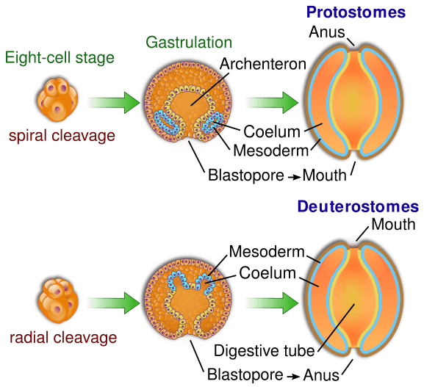
Eucoelomates :
They are divided into Protostomes & Deuterostomes on the basis of different embryonic development. The process of coelom formation in protostomes and deuterostomes is different.
The coelom is categorised into two types on the basis of formation, namely, Schizocoelom and Enterocoelom.

Slide 14
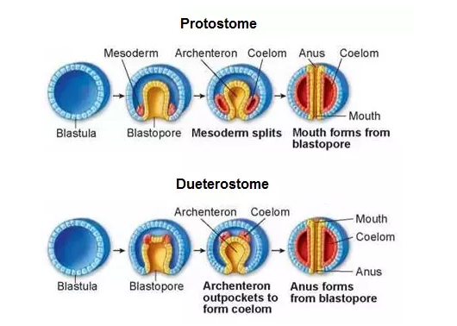

Slide 15
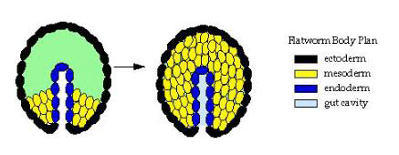
COELOMIC DIVISION OF METAZOA
1. Acoelomata:
No coelom or body cavity.
Embryonic mesoderm remains as a solid layer.
The space between the body wall(ectoderm) and gut(endoderm) is filled up by mesenchyme and muscle fibres.
Ex:Porifera,Coelenterata,
Ctenophora,platyhelminthes and Nemertinea

Slide 16
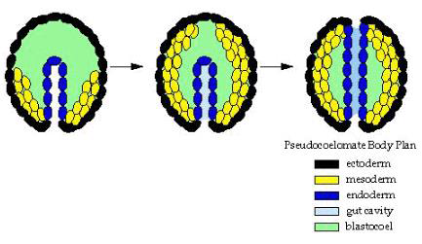
2. Pseudocoelomata:
Body space is a pseudocoel or false coelom .
Embryologically, the pseudocoelom is derived from the blastocoel of the embryo. The internal organs are free within the space, as there is no peritoneum bounding the cavity
Animals possessing it are known as pseudocoelomates.
Ex:Nematoda,Rotifera, Acanthocephala, Ectoprocta and Gastrotricha

Slide 17
3.Coelomata or Eucoelomata
In rest of the bilateria, the body-cavity present between the body wall and gut is lined by a peritoneum. Peritoneum consists of epithelial cells derived by embryonic mesoderm. This type of cavity is known as true coelom and the animals possessing it are known as Eucoelomates.
(Body space is a true coelom enclosed by mesoderm on both sides)
Ex:Annelida, Arthropoda, Mollusca, Echinodermata, Hemichordata and Chordata.
True coelomates are of the following types(Hyman, 1951)
A) Schizocoelomates
B) Mesenchymal coelomates
C)Enterocoelomates

Slide 18
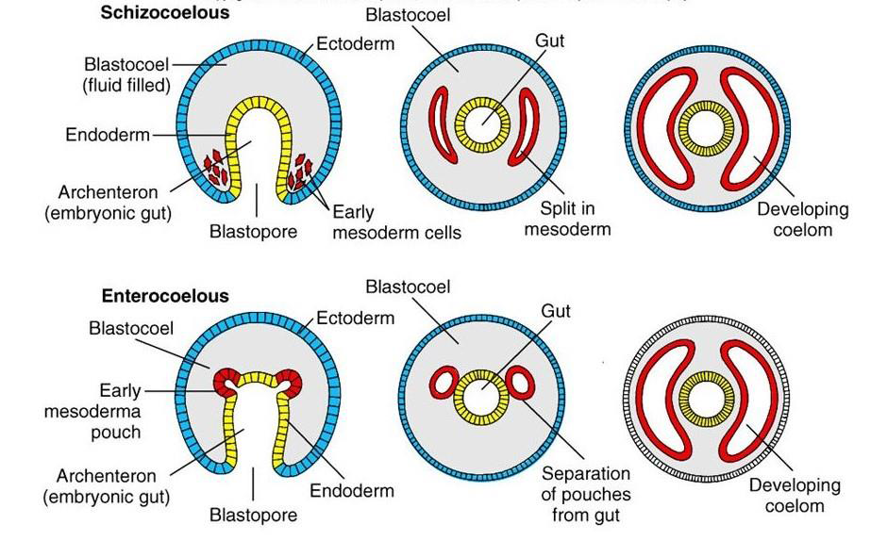

Slide 19
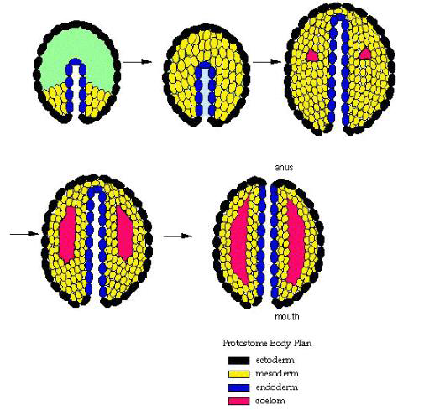
A) Schizocoelomates :
True coelomates in which the body cavity originates by splitting of mesodermal tissue at the time of gastrulation.
This method of coelom formation is called Schizocoelous (Greek: schizo = split),
Sometimes the schizocoelom is filled with blood and is called haemocoel as in arthropods and mollusca.
Ex:Protostomia(Annelids, arthropods &molluscs).

Slide 20
B) Mesenchymal Coelomates:
It is seen only in Phoronida in which mesenchymal cells rearrange to enclose a space or coelom ehich is regarded an aberrant schizocoel.

Slide 21
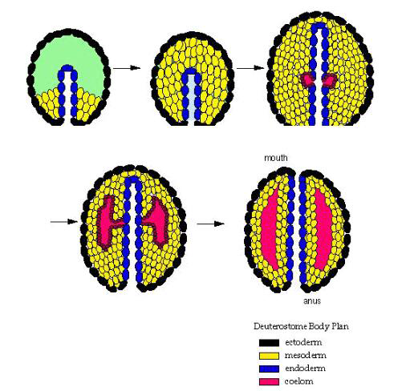
C)Enterocoelomates:
Coelom arises by out-pouching of the archenteron during gastrulation.
After seperation from endoderm, pouches fuse & then expands untill they touch the gut on the inner side and body wall on the outer side. This method of coelom formation is called enterocoelous.
Ex:Deuterostomia(Echinodermata,Hemichordata&chordates)& Branchiopoda.

Slide 22
MODIFICATION OF COELOM:
There are modifications of coelom in different animals
In Aschelminthes:- it forms a pseudocoel not lined with mesoderm
In Annelids:-coelom is divided by septa into chambers corresponding to somites
In Arthropods:-it is formed by scattered spaces collectively known as haemocoel, in which blood circulates.
In Mammals:-coelom is divided by a musculature diaphragm into thoracic and abdominal cavities, with a separate pericardial cavity around the heart.

Slide 23
COELOM FUNCTION
Coelom works as a shock absorber and protects from any kind of mechanical shock.
It gives more flexibility to the body organs to move and protects from any damage on minor bends by cushioning the internal organs.
The coelomic fluid acts as a hydrostatic skeleton, which helps in the locomotion of soft-bodied animals and gives the body a definite shape. Contracting muscles can push against the coelomic fluid because of the fluid pressure.
The coelomocyte cells, that either float freely in the coelom or attached to the wall, support the immune system. They support the immune system by initiating humoral immune response and phagocytosis

Slide 24
COELOM FUNCTION
The coelomic fluid also helps in gaseous transport and transport of nutrients and waste products.
The excretory matter is collected into coelomic fluid and then passed out of the body through nephridia.
Coelom gives the extra space required by organs to develop and function. Eg. pumping action of the heart, carrying a child in the womb, etc. is possible due to coelom.
The gonads arise from its coelomic epithelium and project into coelom. Ova and sperms are extruded through special gonoducts connecting the coelom with the exterior.

Slide 25
ORIGIN AND EVOLUTION OF COELOM
The evolutionary origin of the coelom is uncertain. Initially two theories were proposed :
A. The acoelomate theory: which states that coelom evolved from an acoelomate ancestor.
B. The enterocoel theory: which states that coelom evolved from gastric pouches of cnidarian ancestors. This is supported by research on flatworms and small worms recently discovered in marine fauna.

Slide 26
ORIGIN AND EVOLUTION OF COELOM
Later, R.B Clark (1964) discussed four different theories to regarding origin and evolution of Coelom.
A. Enterocoel theory— First proposed by Lankester in 1877, supported by Lang (1881), Sedgwick (1884)
B. Gonocoel theory - (HatSchek, 1877, 1878), Bergh (1885), Meyer (1890), Goodrich (1946)
C. Nephrocoel theory - (Lankester, 1874, Snodgrass, 1938)
D. Schizocoel theory - (Clark, 1964)

Slide 27
ORIGIN AND EVOLUTION OF COELOM
A. Enterocoel theory: This theory argues that the coelom evolved from the gastric pouches of some cnidarians ancestors such as anthozoans or scyphozoans. These gastric pouches separated out from the main gastric cavity to form the coelomic pouches.
This theory proposes that all bilateral animals are basically coelomate and that acoelomate forms like flatworms are secondarily derived from coelomate ancestors by the loss of the cavity. The enterocoelous mode of coelom formation in the embryogeny of echinoderms, hemichordates and chordates is the main supporting evidence of this theory.

Slide 28
ORIGIN AND EVOLUTION OF COELOM
B. Gonocoel theory: It regards the coelom as the cavity of an expanded gonad and its origin is based on the common association between the gonads and the coelomic epithelium. Bergh believed that coelom initially arose in a segmented condition by enlargement and cavitation of the gonads after the release of gametes. One of the main drawbacks of this theory is that it closely links the origin of coelom with the origin of metameric segmentation and hence it is difficult to account for the unsegmented coelomates. There is no evidence that the unsegmented coelomates have originated from the segmented ancestors. This theory has no embryological support because gonads do not arise before the coelom.

Slide 29
ORIGIN AND EVOLUTION OF COELOM
C. Nephrocoel theory: Proposed by Lankester in 1874. The coelom originated as an expanded nephridia. This theory however, was never taken seriously because protonephridia has been described in coelomates and also excretory organs are absent in some coelomates like echinoderms.

Slide 30
ORIGIN AND EVOLUTION OF COELOM
D. Schizocoel theory: According to this theory, the coelomates evolved from an ancestral acoelomate like flatworms by hollowing out of the parenchymal cells of the mesenchyme. Some of these cells formed the peritoneum. According to this theory, the acoelomate body plan is primary and ancestral to the coelomate plan.
The acoelomate flatworms, thus, form the basic group in the evolution of bilateral animals. The schizocoel mode of coelom formation in the embryonic development of annelids and molluscs would claim as supporting evidence of this theory. However, the evolution of coelom is not related to gonads or endodermal pouches of lower forms.

